Slide 1


TEAM 2
IRIS TUMOUR DETECTION USING CONVOLUTIONAL NEURAL NETWORKS (CNN)
TEAM MEMBERS:
KEERTHANA.G.S
HARI MEGHANA KAVALA
MANOGNA BANDLAMUDI

Slide 2
PROBLEM STATEMENT:
•The goal of this project is to develop a Convolutional Neural Network (CNN) model capable of detecting tumors in iris images to aid early diagnosis. A website is created to showcase and provide access to the model, allowing users to upload iris images and receive real-time tumor detection results to facilitate diagnosis.
•The model should classify images of the iris as either normal or tumor-present with high accuracy.
•Interns will learn about iris tumors, data preprocessing techniques, and model evaluation metrics, ultimately providing a foundation in using artificial intelligence for medical diagnostics.

Slide 3
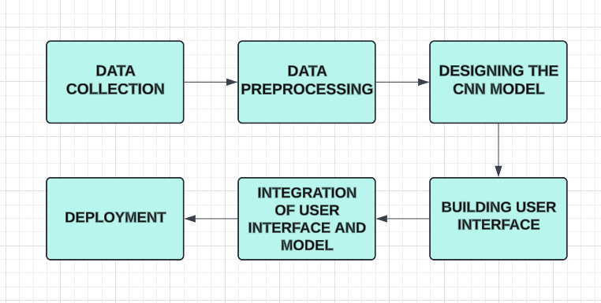
PROJECT FLOW:

Slide 4

PROJECT OVERVIEW:
Register:
The registration page allows new users to create an account for the Iris Tumor Detector website. Users can enter their details (such as username and password) into the form fields provided.
Login:
The login page allows users to access their accounts on the Iris Tumor Detector application. It presents a form where users enter their credentials, typically username and password.

Slide 5

Upload Image:
The "upload image" feature allows users to submit an image—either showing a tumor or not through the application.
Detect Image:
The "detect image" feature processes the user-uploaded image to determine if a tumor is present by using a Convolutional Neural Network (CNN) algorithm
Show result:
After processing the image through the CNN algorithm, the application displays a clear result indicating whether a tumor is detected or not.

Slide 6
TECH STACK:
Programming Language: Python
Python is widely used in deep learning and machine learning due to its simplicity and extensive libraries.
Frontend: HTML,CSS
Backend: Django
Django provides a robust framework for developing a web-based UI for users to upload images and view results.
Database: sqlite3
This is used to store user data ensuring organized and accessible data storage.

Slide 7
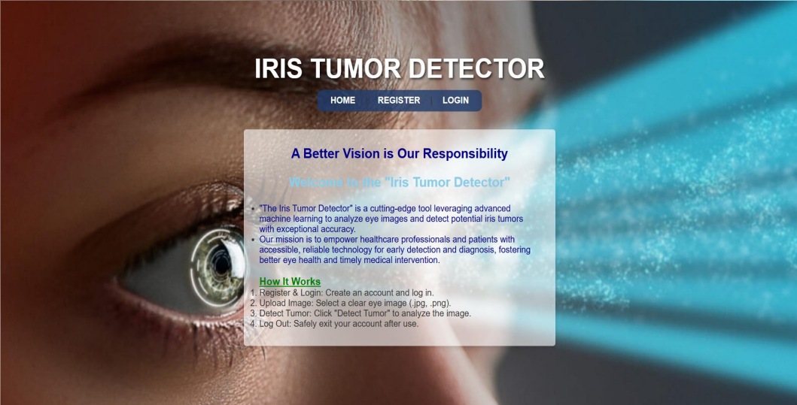
HOME PAGE

Slide 8
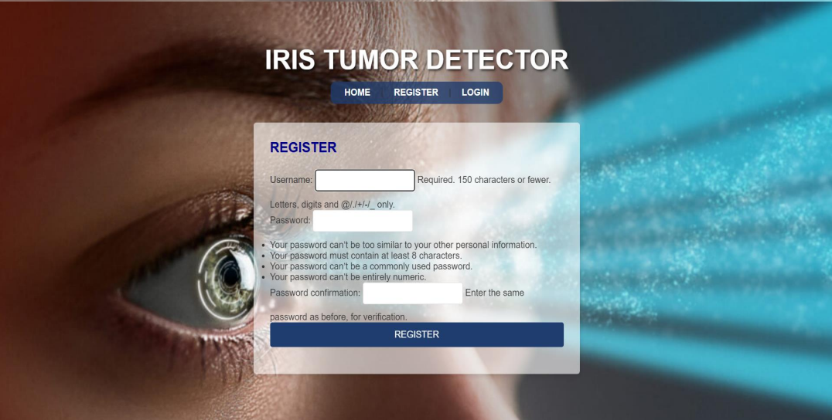
REGISTER PAGE

Slide 9
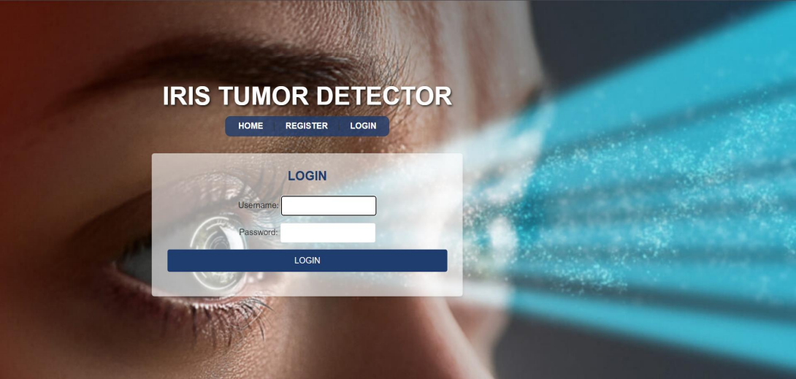
LOGIN PAGE

Slide 10
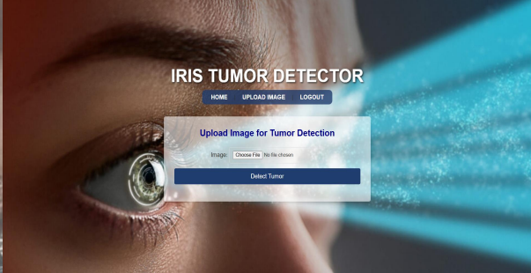
UPLOAD IMAGE PAGE

Slide 11
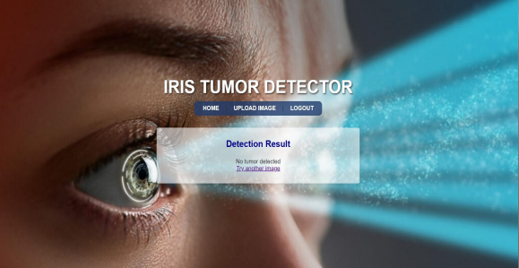
RESULT PAGE(NO TUMOR)

Slide 12
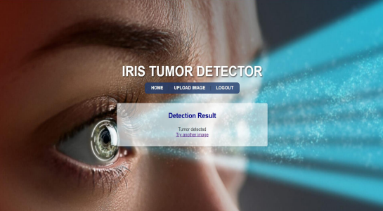
RESULT PAGE(TUMOR)

Slide 13
CONCLUSION:
The project successfully showcases the integration of Convolutional Neural Networks (CNNs) within a Django web application to facilitate tumor detection in medical imaging.
With a powerful combination of artificial intelligence and an accessible interface, this solution aims to support medical professionals in achieving accurate and timely diagnosis of iris tumors, potentially improving patient outcomes through early detection and intervention.

